Slide 1
Testing Java web applications
Dr Jim Briggs

Slide 2
Introduction to testing

Slide 3
Verification and validation
Definitions (Boehm):
Verification: Are we building the product right? (i.e. does it meet the requirements specification?)
Validation: Are we building the right product? (i.e. does the requirements specification describe what the customer wants?)
Check at each stage of the process using documents produced during previous stage
Do it early to catch problems early

Slide 4
Two types of V&V
Static
analysis and checking of documents (including source code)
performed at all stages of the process
Dynamic
exercise the implementation ("testing")
obviously only performed when executable available (which might be prototype)
Neither is sufficient by itself.
Dynamic testing is the "traditional" approach, but static techniques are becoming more sophisticated.
Some people believe static techniques make testing unnecessary, but this is not a widely held view.

Slide 5
What is software testing?
Software testing can be stated as the process of validating and verifying that a software program/application/product:
meets the requirements that guided its design and development;
works as expected; and
can be implemented with the same characteristics
[Wikipedia]
Contrast with static verification techniques

Slide 6
Why do we test software?
Software testing is an investigation conducted to provide stakeholders with information about the quality of the product or service under test.
Software testing can also provide an objective, independent view of the software to allow the business to appreciate and understand the risks of software implementation.
Test techniques include, but are not limited to, the process of executing a program or application with the intent of finding software bugs (errors or other defects).

Slide 7
Categories of testing
Way we do it:
manual
automated
Approach we take:
black box
white box
grey box
What we test:
unit testing
integration testing
system testing
user acceptance testing

Slide 8
Testing terminology 1
Testing involves executing the program (or part of it) using sample data and inferring from the output whether the software performs correctly or not.
This can be done either during module development (unit testing) or when several modules are combined (system testing).
Defect testing is testing for situations where the program does not meet its functional specification.
Performance testing (aka statistical testing) tests a system's performance or reliability under realistic loads.
This may go some way to ensuring that the program meets its non-functional requirements.

Slide 9
Testing terminology 2
Debugging is a cycle of detection, location, repair and test.
Debugging is a hypothesis testing process.
When a bug is detected, the tester must form a hypothesis about the cause and location of the bug.
Further examination of the execution of the program (possibly including many reruns of it) will usually take place to confirm the hypothesis.
If the hypothesis is demonstrated to be incorrect, a new hypothesis must be formed.
Debugging tools that show the state of the program are useful for this, but inserting print statements is often the only approach.
Experienced debuggers use their knowledge of common and/or obscure bugs to facilitate the hypothesis testing process.
After fixing a bug, the system must be retested to ensure that the fix has worked and that no other bugs have been introduced. This is called regression testing. In principle, all tests should be performed again but this is often too expensive to do.

Slide 10
The testing cycle
Run program
Detect defect
Locate error
Design repair
Make repair

Slide 11
Locating the error
Start with a hypothesis about where in the program source code the error is located:
is the error at point X?
run the program and see if there was no error before reaching X and the error manifested itself after X
Usual to work backwards from the point where an erroneous output was returned

Slide 12
Designing the repair
Start with a hypothesis about what caused the error:
statement X did Y
Design a fix
statement X should do Z
Implement the fix
see whether the change repairs the bug
see whether the change has broken other things

Slide 13
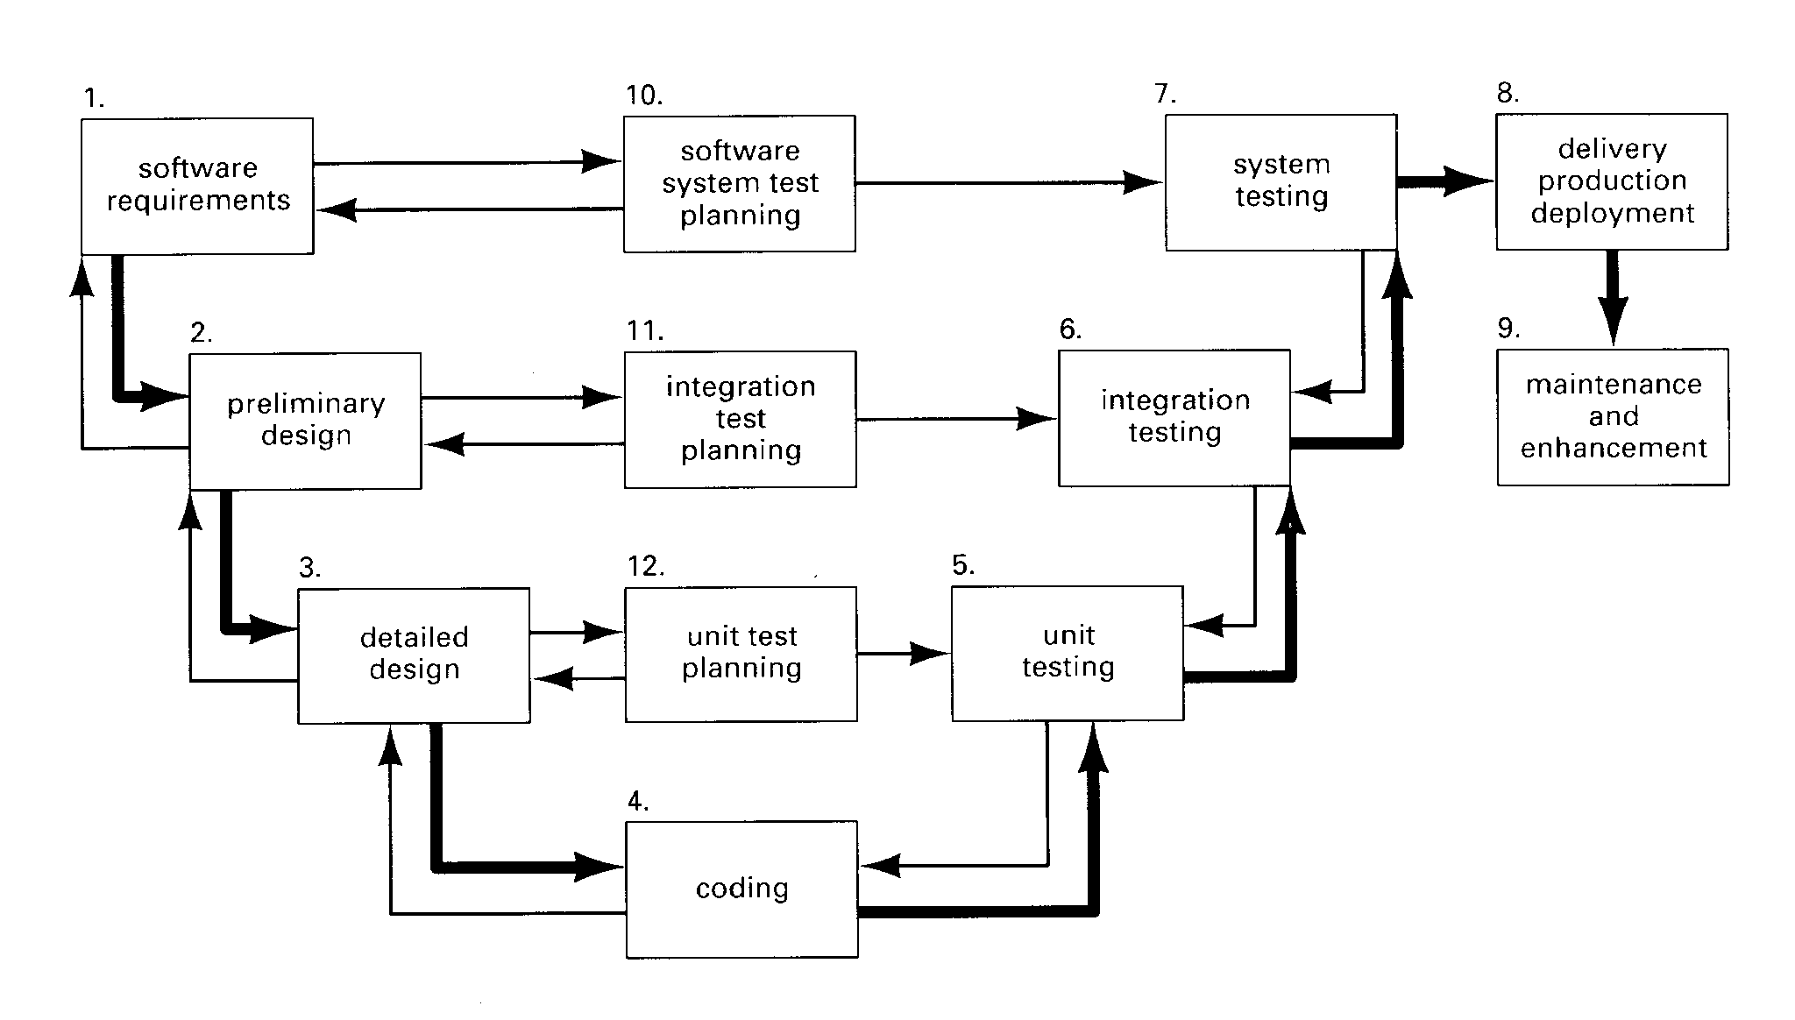
Planning testing
Davis, Software Requirements

Slide 14
Specifics for web applications

Slide 15
Characteristics of web systems
Distributed system (by definition)
client/server
Large scale system (often)
lines of code
size of data (database)
complex interactions between data
Development done away from live system (normally)

Slide 16
Consequences
Unit testing best done without web
User acceptance testing best done with real users
System testing can be automated (Selenium)

Slide 17
JUnit

Slide 18
Selenium

Slide 19
Other tools

Slide 20
Other tools
Hudson / Jenkins

Slide 21
Final thoughts
How do you know when your program is bug free?
You don't
How do you know how many tests are needed?
Test until fear turns to boredom

